Slide 1


onClick XML
Notes:
Tác giả: Trần Duy Thanh
Phone: 0987773061
Email: duythanhcse@gmail.com
Blog: http://duythanhcse.wordpress.com

Slide 2
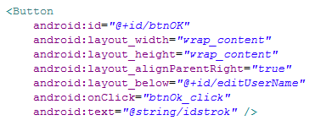
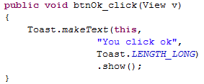
1. Onclick in XML
Using onClick view property of view (android:onClick) in xml

Slide 3
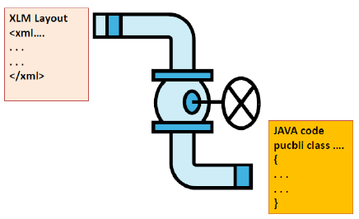
1. Onclick in XML
Using onClick view property of view (android:onClick) in xml
setContentView(R.layout.main)

Slide 4


Hey! Coding is easy!
END

